Slide 1

Bookie: Decentralized Data Marketplace
Reclaim control of your digital identity.
Empowering individuals in the data economy.

Slide 2


The Problem & Our Solution
The Problem: Data Exploitation
The Solution: Bookie's Vision
Your data is collected, commercialized.
Privacy-focused, decentralized marketplace.
Zero control, no privacy, no profit.
Full data ownership and monetization.

Slide 3





Key Features: Empowering Users
Privacy First
Monetize Data
On-device data encryption.
Earn income securely.
Your data remains private.
Sell your personal data.
Blockchain Security
Decentralized Control
Stellar network transparency.
No central authority.
Transactions are secure.
You own your data.

Slide 4
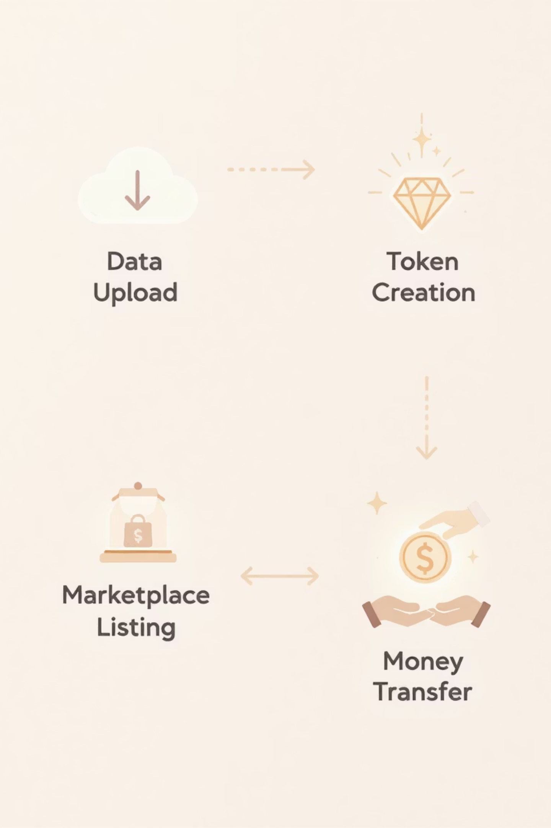




How It Works: Seamless Process
Upload & Encrypt
Data encrypted locally.
User device security.
Create Data Token
Encrypted data tokenized.
On Stellar network.
List on Marketplace
Token listed for sale.
Accessible to buyers.
Sell Securely & Earn
Buyers purchase token.
Direct payment to you.

Slide 5
Technology Architecture: Built for Scale
Frontend Stack
Blockchain & Smart Contract
Next.js 15 for speed.
Stellar Soroban backbone.
TypeScript for reliability.
Rust for performance.
Tailwind CSS for UI.
Decentralized Storage
Authentication
IPFS for distributed files.
Freighter Wallet integration.
Pinata for reliable pinning.
WebAuthn Passkeys for security.

Slide 6
Project Status & Roadmap
Current Status: Ready for Launch ✅
Future Plans (Roadmap): Scaling Up 🔮
Core marketplace complete.
Extension development for browsers.
Wallet integration active.
Advanced analytics dashboard.
Data encryption operational.
Multi-chain support expansion.
Secure transactions enabled.
Community governance.

Slide 7
Your Data, Your Future
"I like this innovation because I don't like 'Sugar' and 'Alien.'"

